Slide 1
DevOps Vikas College of Engineering and Technology
(Seminar given by)
Rebba DurgaLakshmi
Roll No:18NQ5A0507
4th CSE (Sec : A)

Slide 2
INTRODUCTION
What is DevOps ?
Why DevOps ?
DevOps Life cycle
What are the Tools in DevOps
What is the Need of DevOps

Slide 3
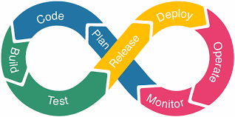
What is DevOps
DevOps is basically a combination of two words, “development”and”operations.”
DevOps is a culture that follows the set of practices to combine the DevOps and IT operation teams.
Its major goal is to shorten the system delivery life cycles.
This culture increases the organization's speed to deliver the applications and services.

Slide 4
Why DevOps
DevOps is important because it's a software development and operations approach that enables faster development of new products and easier maintenance of existing deployments.

Slide 5
DevOps Life Cycle

Slide 6
DevOps Life cycle phases
Plan: Initially plan yourself regarding the type of application you need to develop.
Code: Code the application as per the client requirement. with the plan, you have made in the initial step.
Build: Build the application by performing the integration of various codes you have done in the previous step.
Test: This is the heart of the application. Test the application that you have built so far. And the rebuilt the application if necessary.
Releases: If you succeed in the Test phase, then its time to release the application into Live.
Deploy: Deploy the code into a cloud environment for further usage. It is performed in such a manner any changes made should not affect the functioning of high traffic website.
Operate: Perform the operation on the code if any have.
Monitor: Monitor the performance of the application as per the client requirement. Keep a note on the performance of the application

Slide 7
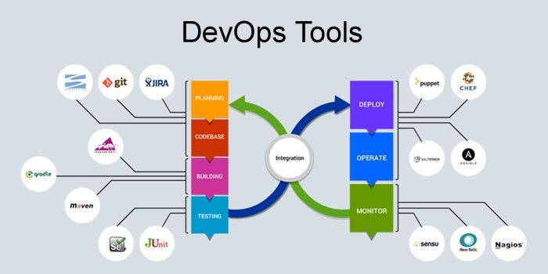
What are the Tools in DevOps

Slide 8
The most popular DevOps Tools are
The top order of DevOps tools,Docker is the most popular and most commonly used DevOps tool by the DevOps Engineers.
The second most popular DevOps tool is Ansible.
The third popular DevOps tool is Git.
Number of tools in DevOps ex:Puppet , Chef ,Jenkins ,Nagios
Splunk.

Slide 9
What is the need of DevOps
Development of an application is not as simple as people think.
As everybody knows after development, the application needs to go under the testing phase.
And we can predict the time required for the project to get into production.
In some cases, it goes on time back for the purpose of development and in some cases, it goes many times.
So it means it's a time-consuming process. So as an alternative, we need a process that delivers the project in a short span of time.
So there comes a need for DevOps

Slide 10
